Slide 1
Improving Patient Care

Slide 2
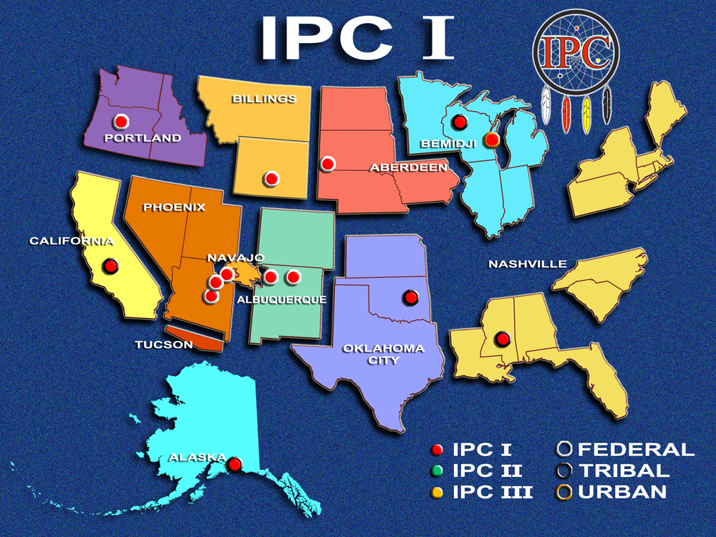
2007-2009
Notes:
We have come a long way from the original 14 sites.
To tell you more about the Improving Patient Care Program (IPC for short), we launched this program within the IHS, Tribal and Urban Indian health system in 2006 in an effort to transform our health care delivery system.
The IPC Program began with 14 IHS, Tribal and Urban sites whose aim was to use change improvement principles to improve the manner in which they provided health care. A heavy emphasis is placed on the chronic care model and the prevention of chronic disease.
These teams have been passionately working to redefine our clinical services to create a HEALTH SYSTEM (“Medical Home”) to allow patients to receive high quality care through better management of health care services.

Slide 3
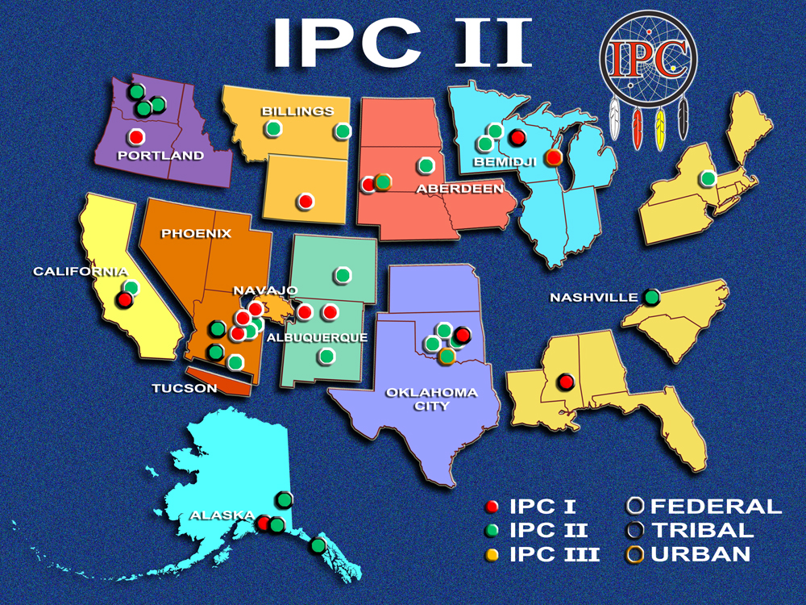
2009-2010
Notes:
In IPC II there were 38 IPC sites who have established care teams in all 12 Areas, representative of 22 federal, 13 tribal, and 3 urban programs, totaling over 350 participants.

Slide 4
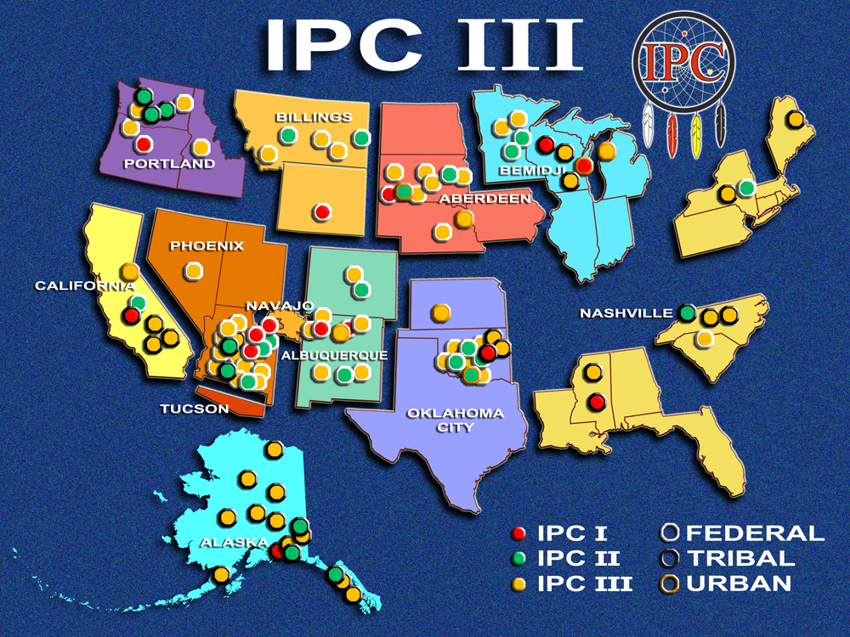
2011-12

Slide 5
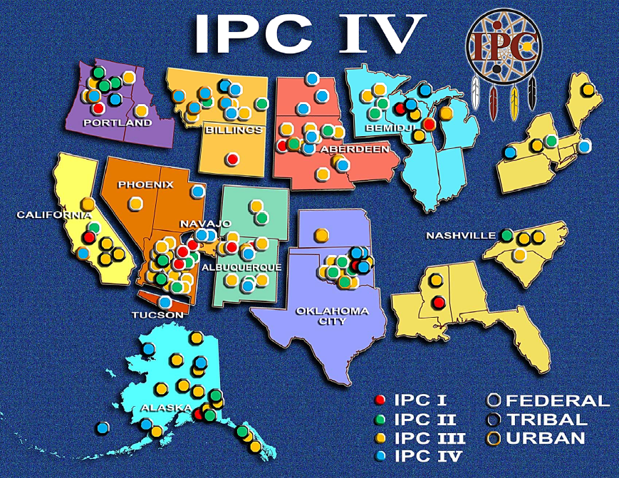
2012-13

